Slide 1
Course Era Capstone IBM Professional DATA SCIENCE Capstone Jan 202
“Want to open a New Multiplex in Tampa? Here's what data says”
Submitted by
Sai Suraj Argula

Slide 2
Table Of Contents
Introduction
Business Problem
Approach
Data Requirements
Data Collection
Audience
Methodology
Discussion
Results
Conclusion

Slide 3
Introduction
In the era of fast-moving world, Movie theatres play an important role of providing relaxation to General people. Though online streaming services like Netflix, Hotstar and Amazon prime taken over a part of finances and profits in the entertainment Industry, movie theatres still be able to bring crowds who prefer experience compared to convenience. Movie theatres become one stop destination for entertainment, food and beverages. Increasing number of movies, along with increase in millennials who prefer theatres, demand for new movie theatres in the neighborhood which is accessible increased.

Slide 4
Business Problem
Foreseeing increased demand of New Movie theatres, company XYZ Entertainment wants to expand by investing in construction of new theatres. As a pilot project XYZ Entertainment choose City of Tampa as a start point to identify possible places to construct theatre. XYZ Entertainment needs the theatres to be constructed in the neighborhoods which are away from existing theatres, so that they can avoid possible competition.

Slide 5
Approach
As company wants to identify the neighborhoods which doesn’t have and have existing theatres. Analytical team decided to use K means clustering to cluster the neighborhoods into three groups of having more, moderate and less concentrations

Slide 6
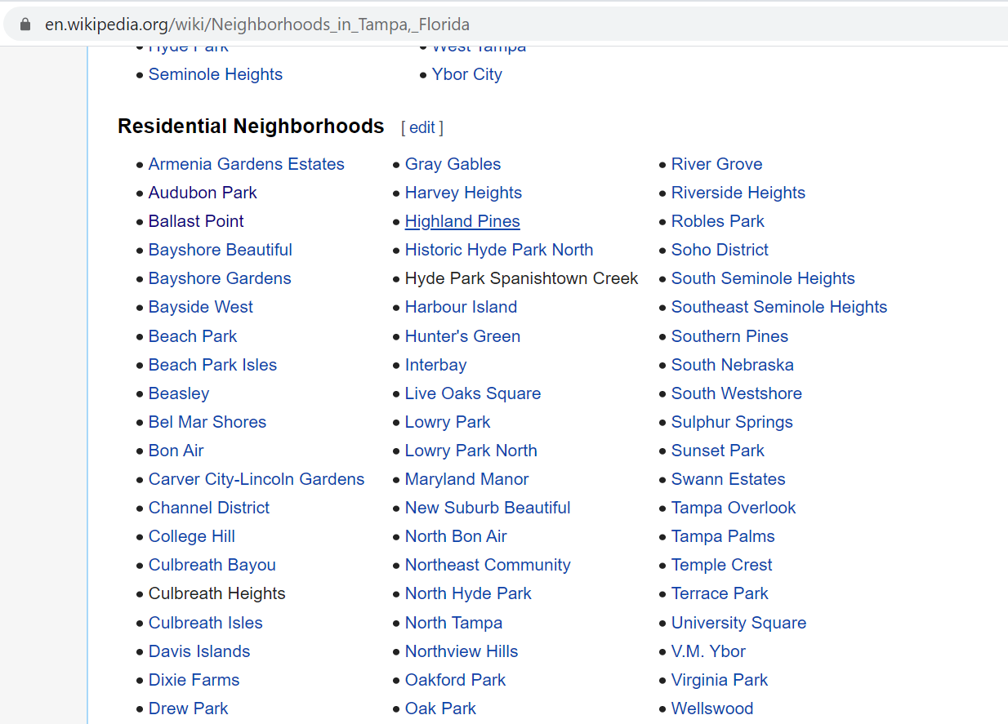
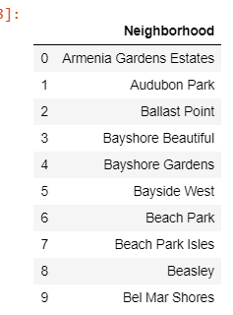
Data Collection by Web scraping
Data collection from the below website and webscraping using BeautifulSoup and converting into Pandas Dataframe.
https://en.wikipedia.org/wiki/Neighborhoods_in_Tampa,_Florida

Slide 7
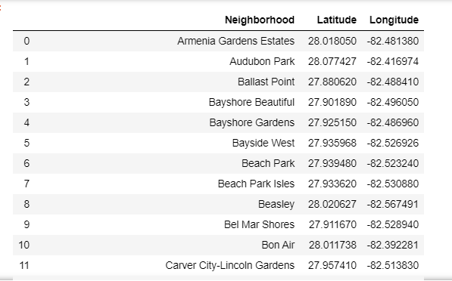
Data Frame of Neighborhoods in Tampa, Florida

Slide 8
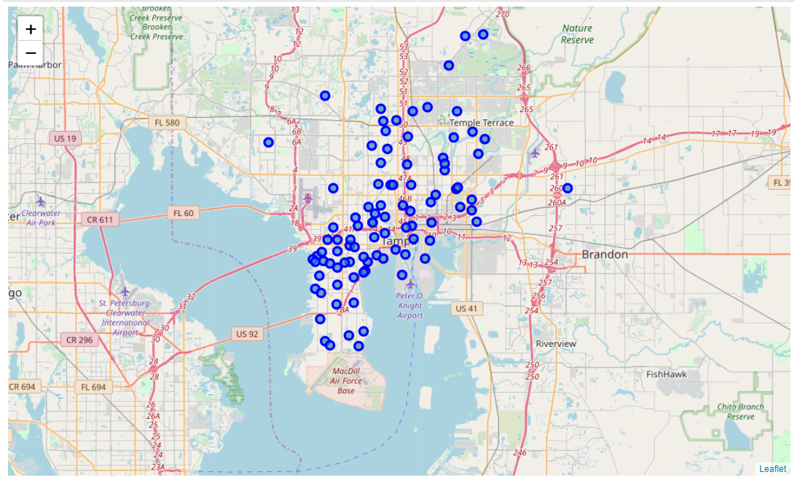
Data Visualization of the neighborhoods in Tampa map using Folium

Slide 9
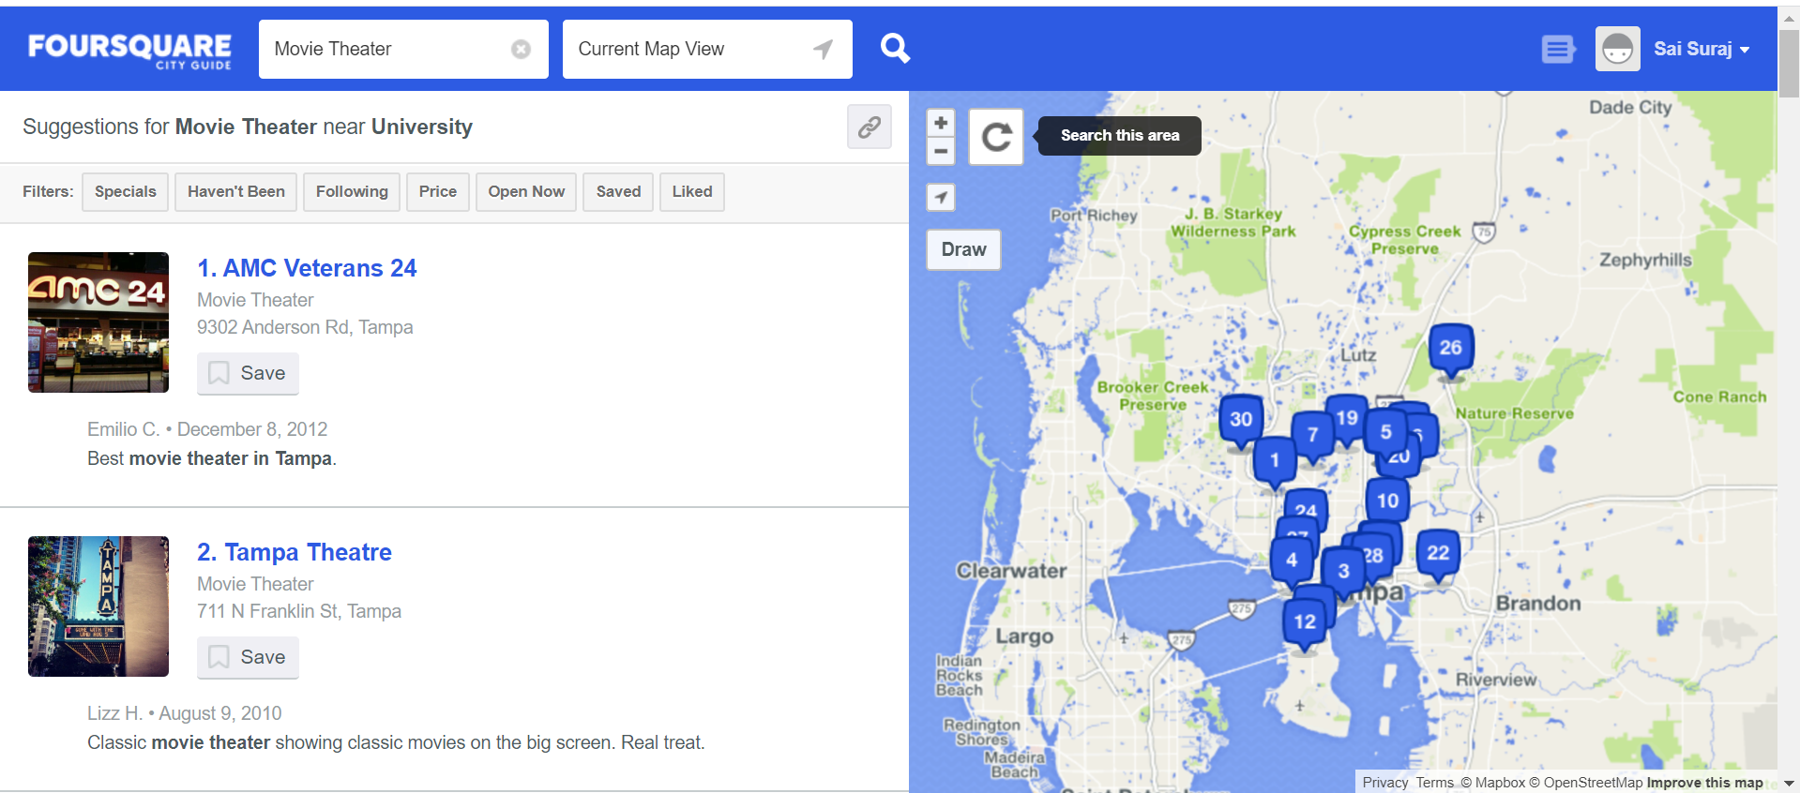
Four Square Data of theaters in the neighborhoods in Tampa

Slide 10
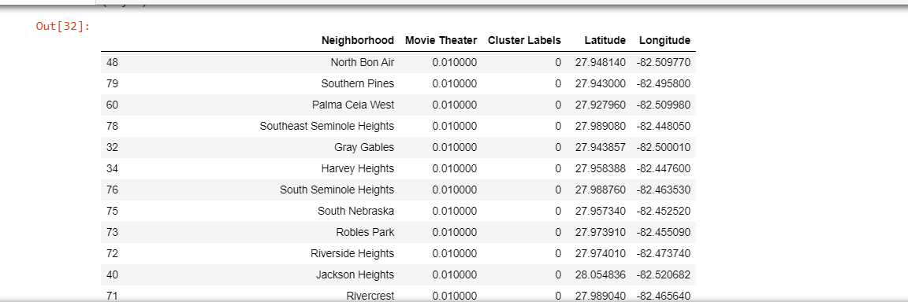
Cluster labels of each neighborhood into clusters, on theatre concentration
By K-means Clustering

Slide 11
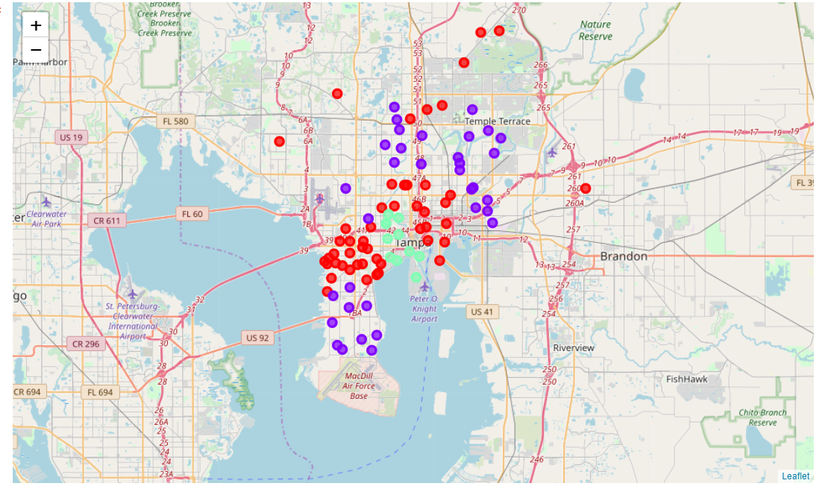
Results

Slide 12
Conclusion
Data available about neighborhoods and Movie theaters helped Company XYZ Entertainment to identify one of the neighborhoods with the low concentration of theaters to begin their operations.

